Slide 1

8 PowerShell Tips & Tricks for System Admins
New Horizons
Computer Learning Centers

Slide 2
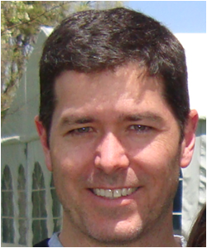
Today’s Agenda
Introduction
8 PowerShell Tips & Tricks for System Admins
Q & A
Shawn Stugart
Senior Technical Trainer
shawn.stugart@nhls.com
https://github.com/simplescripter
CISSP, CEH, MCITP, MCTS, MCSE:S, MCT, MCSA:S, MCDST, CCNA, CCSI, SCNP, ITIL, NSNS, CIW-SA, A+, Network+, Security+, CySA+
New Horizons Learning Solutions

Slide 3

Who is New Horizons?
New Horizons is a proven, worldwide training provider with flexible learning solutions covering a broad spectrum of topics taught by industry-leading instructors.

Slide 4

Facts to Consider
Largest International Network
2,100 Classrooms
2,400 Instructors in 56 Countries
3 Million Student Days of Training per Year
New Horizons - NHLS
14 State-of-the-Art Locations
Hundreds of Class Offerings
The Largest Guaranteed-to-Run Schedule

Slide 5
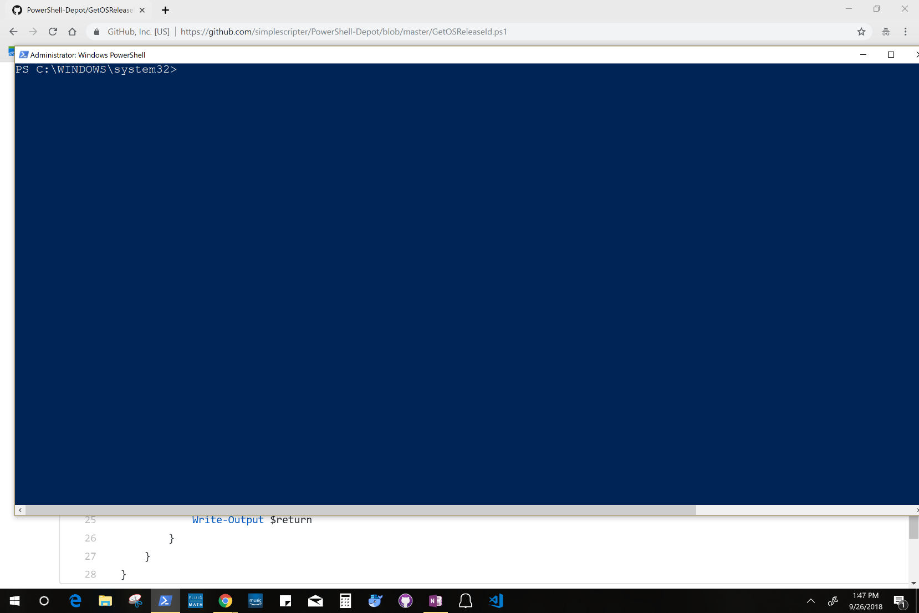
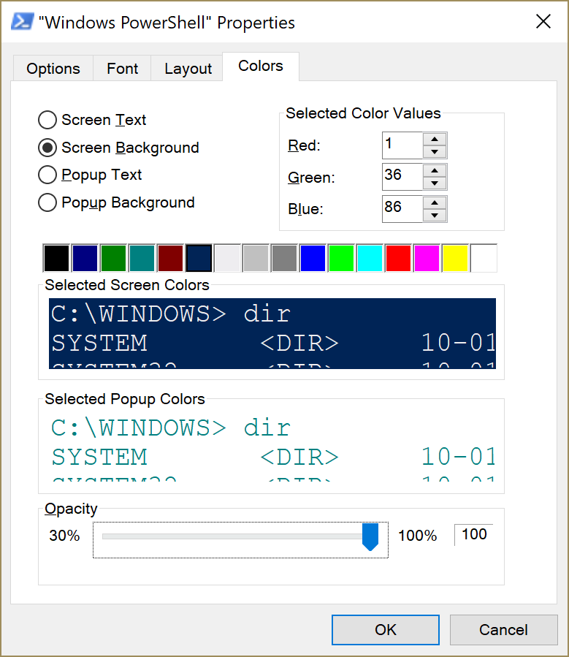
#1: Console Transparency

Slide 6
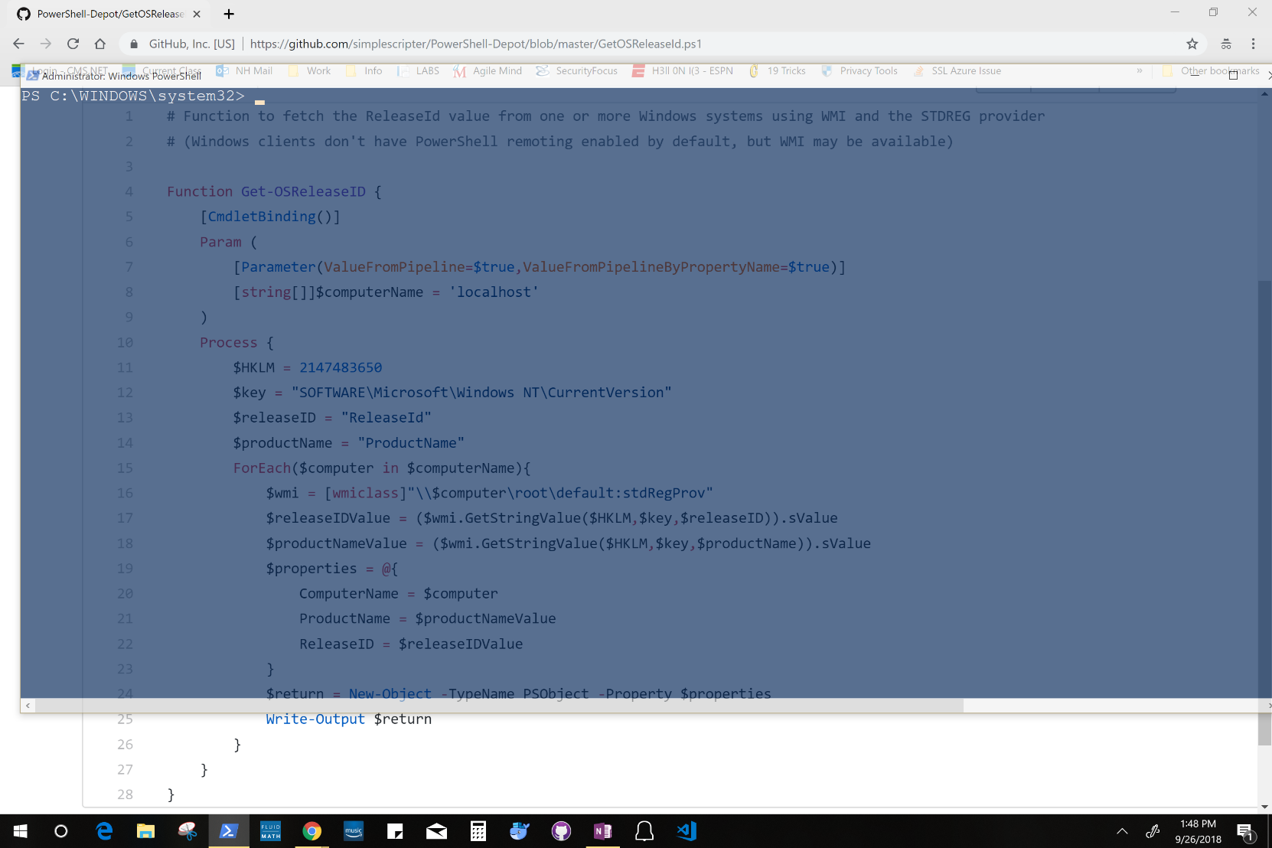
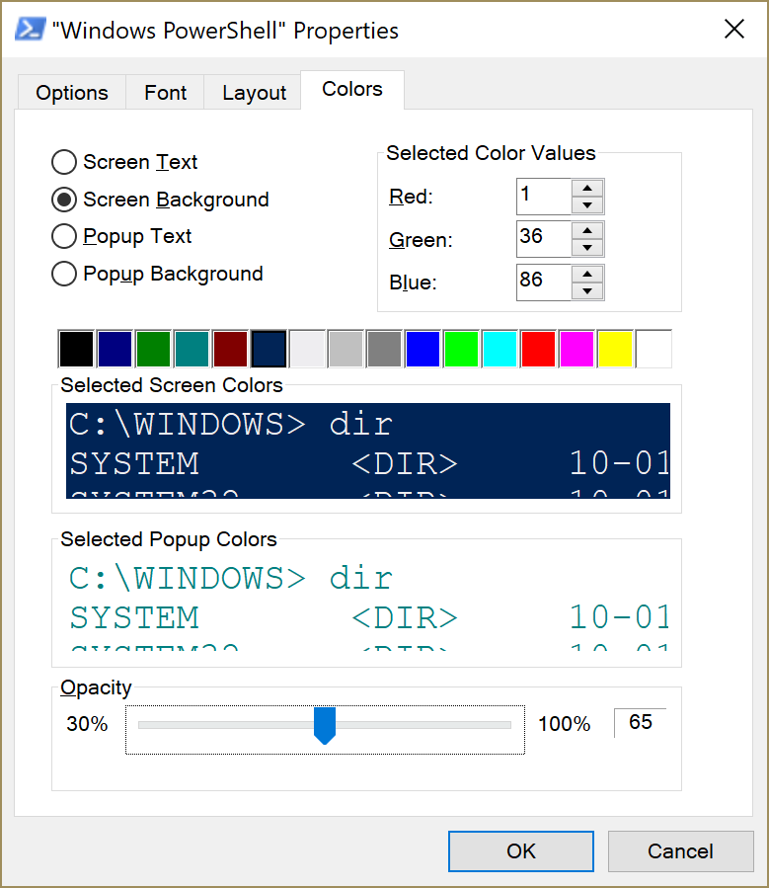
#1: Console Transparency

Slide 7
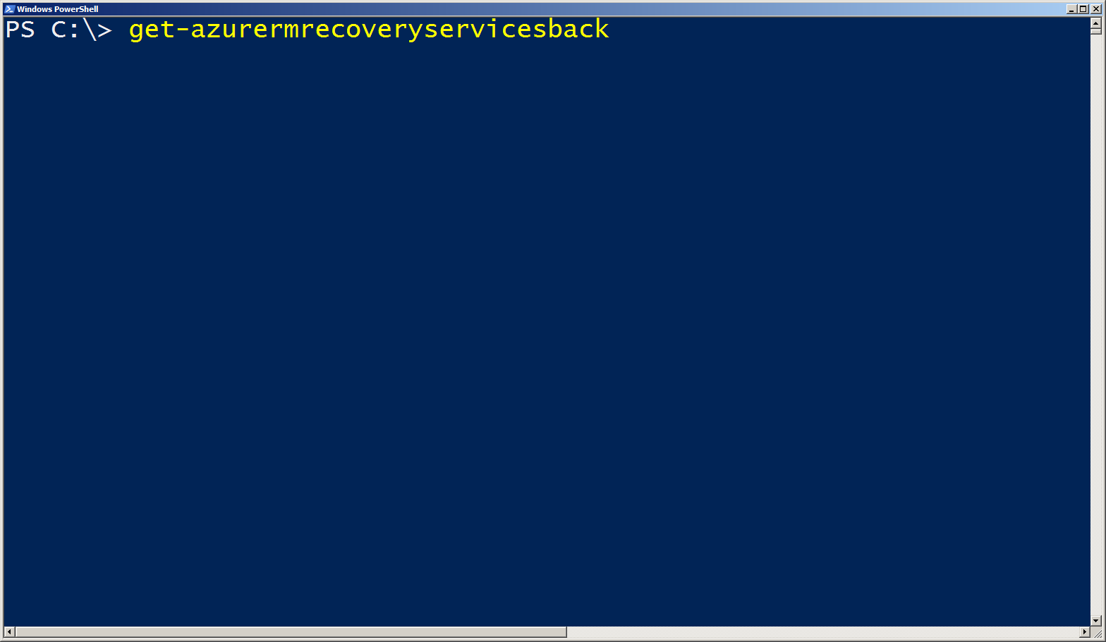
#2: Tab Auto-Complete/Ctrl+Space

Slide 8
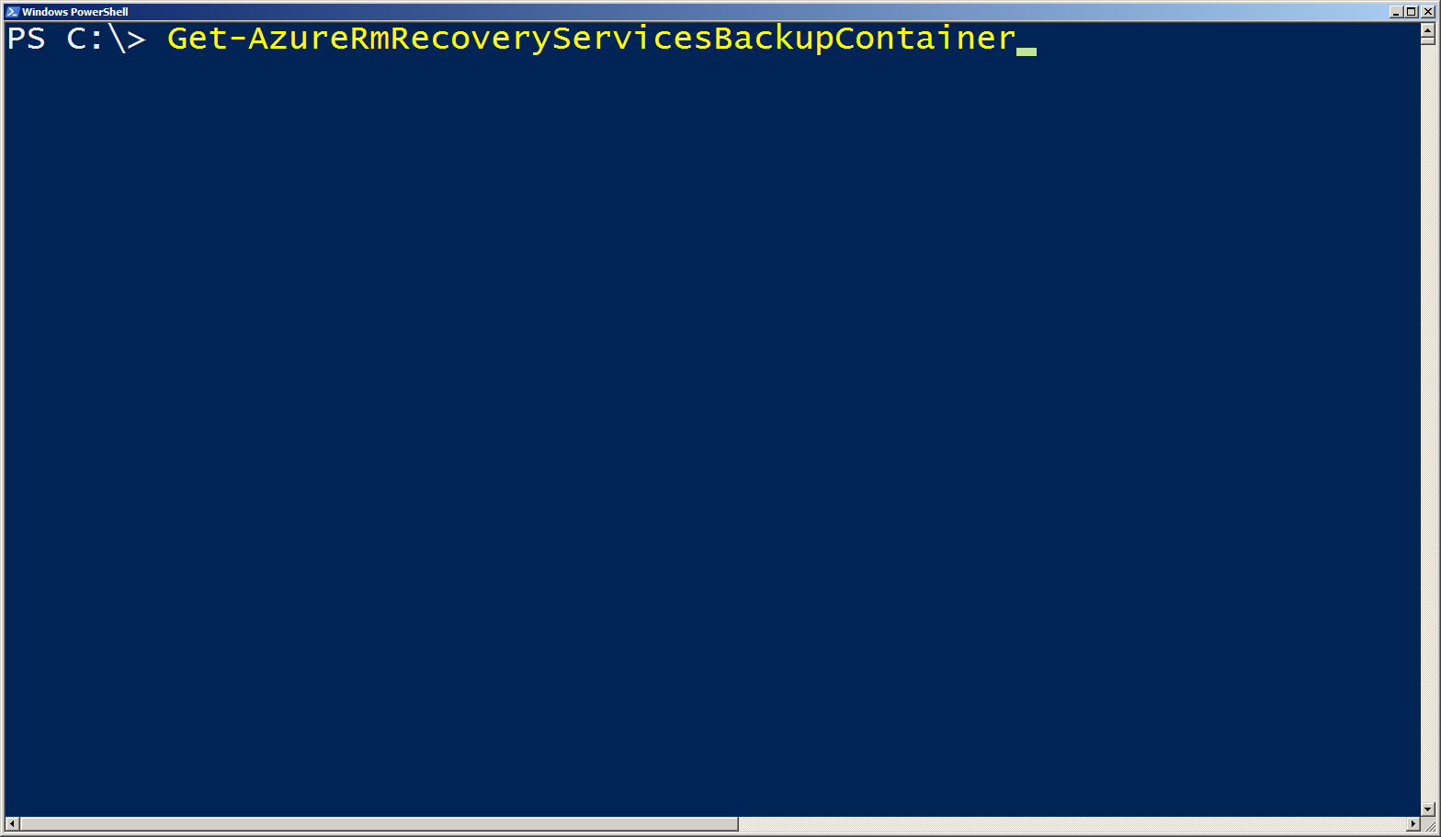
#2: Tab Auto-Complete/Ctrl+Space

Slide 9
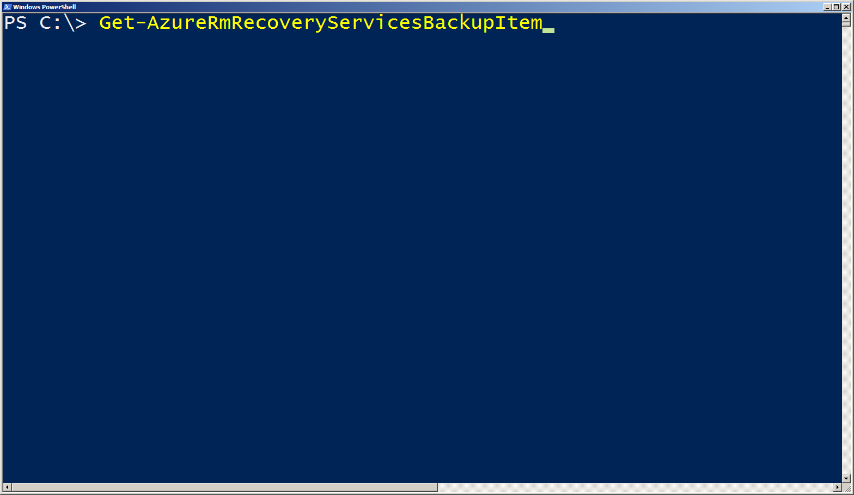
#2: Tab Auto-Complete/Ctrl+Space

Slide 10
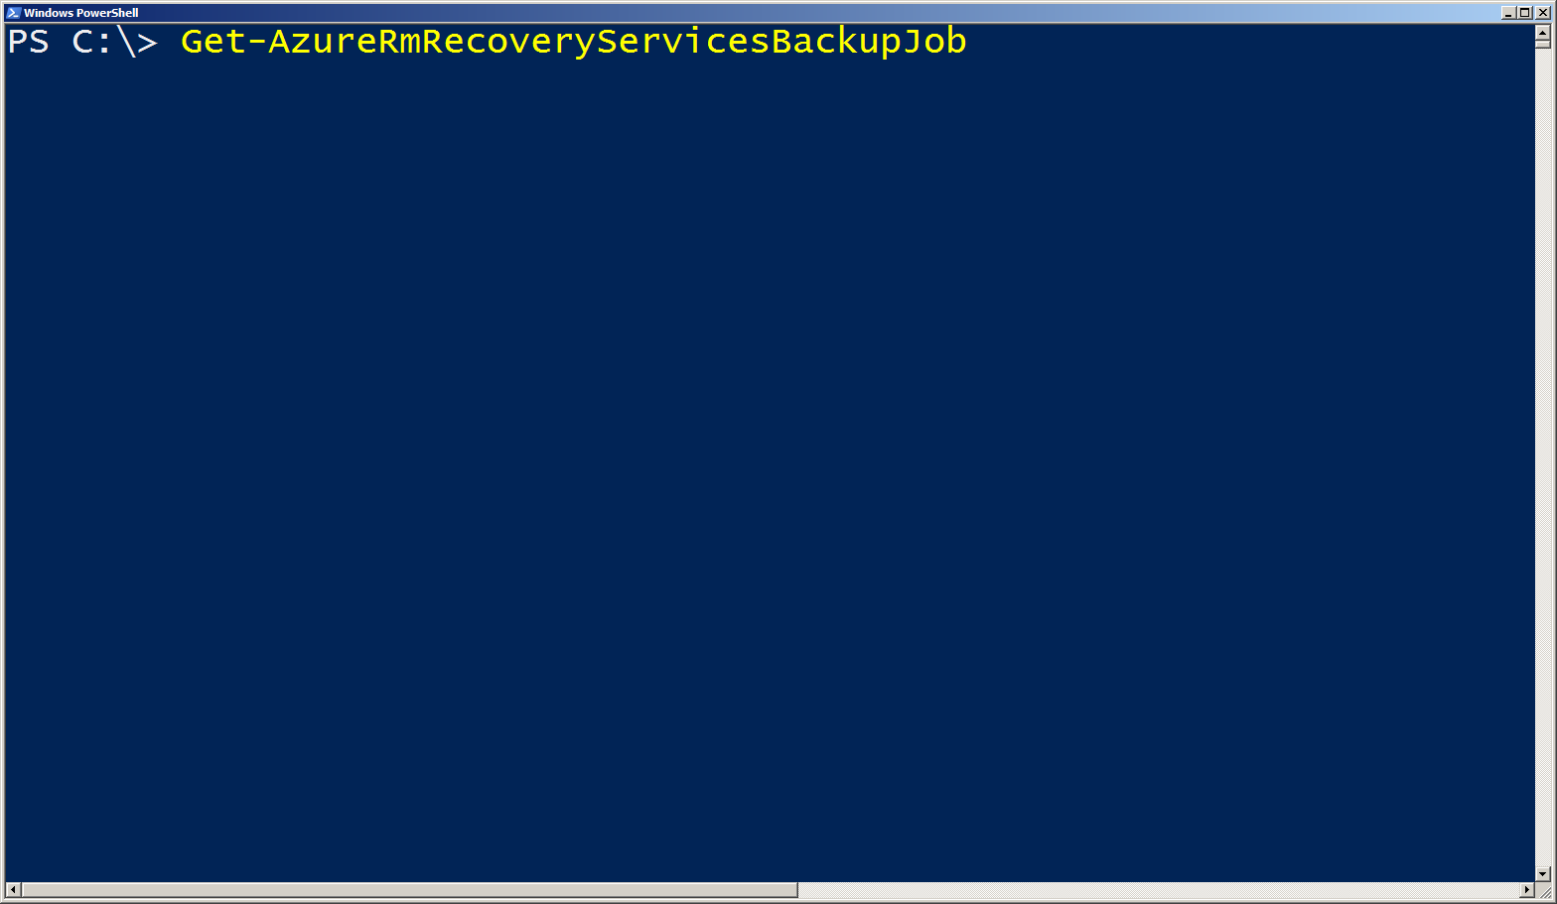
#2: Tab Auto-Complete/Ctrl+Space

Slide 11
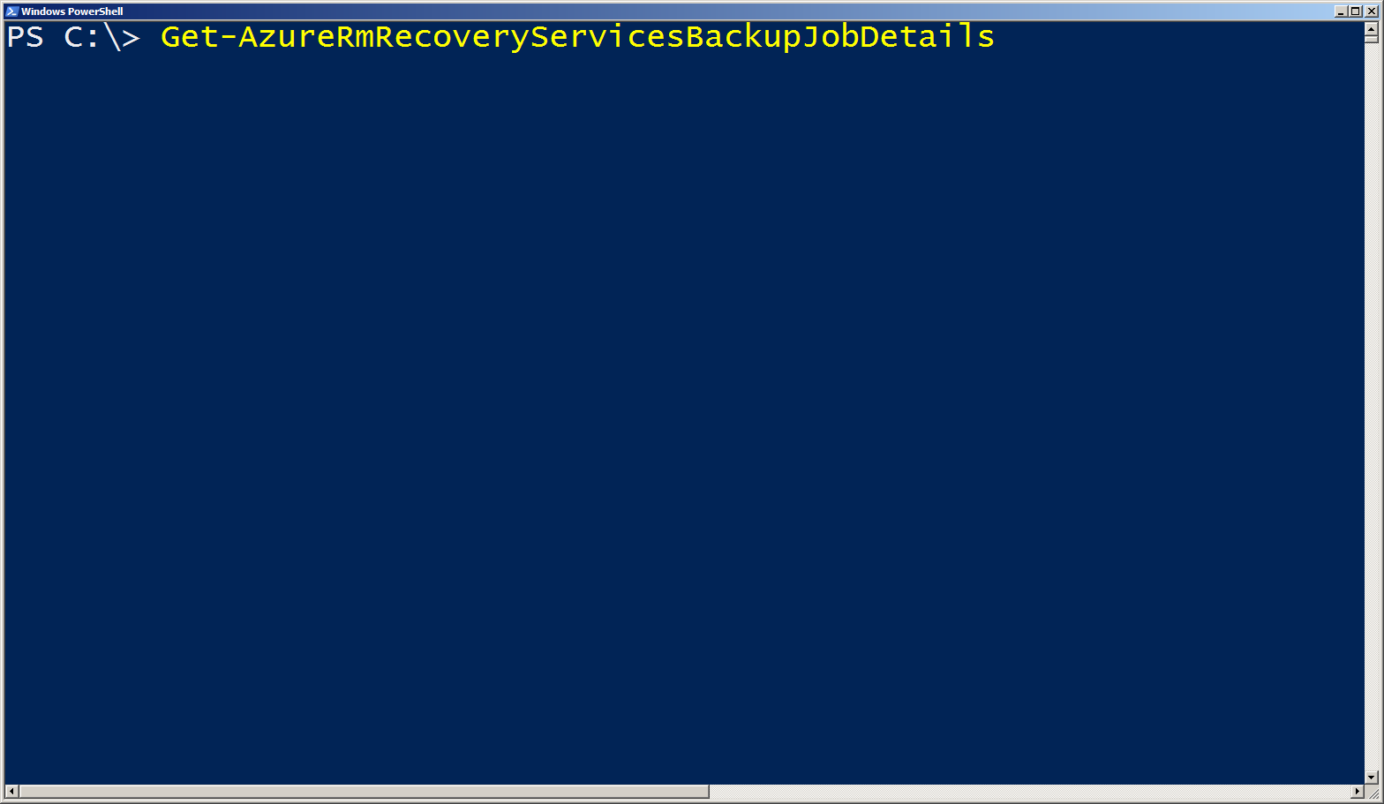
#2: Tab Auto-Complete/Ctrl+Space

Slide 12
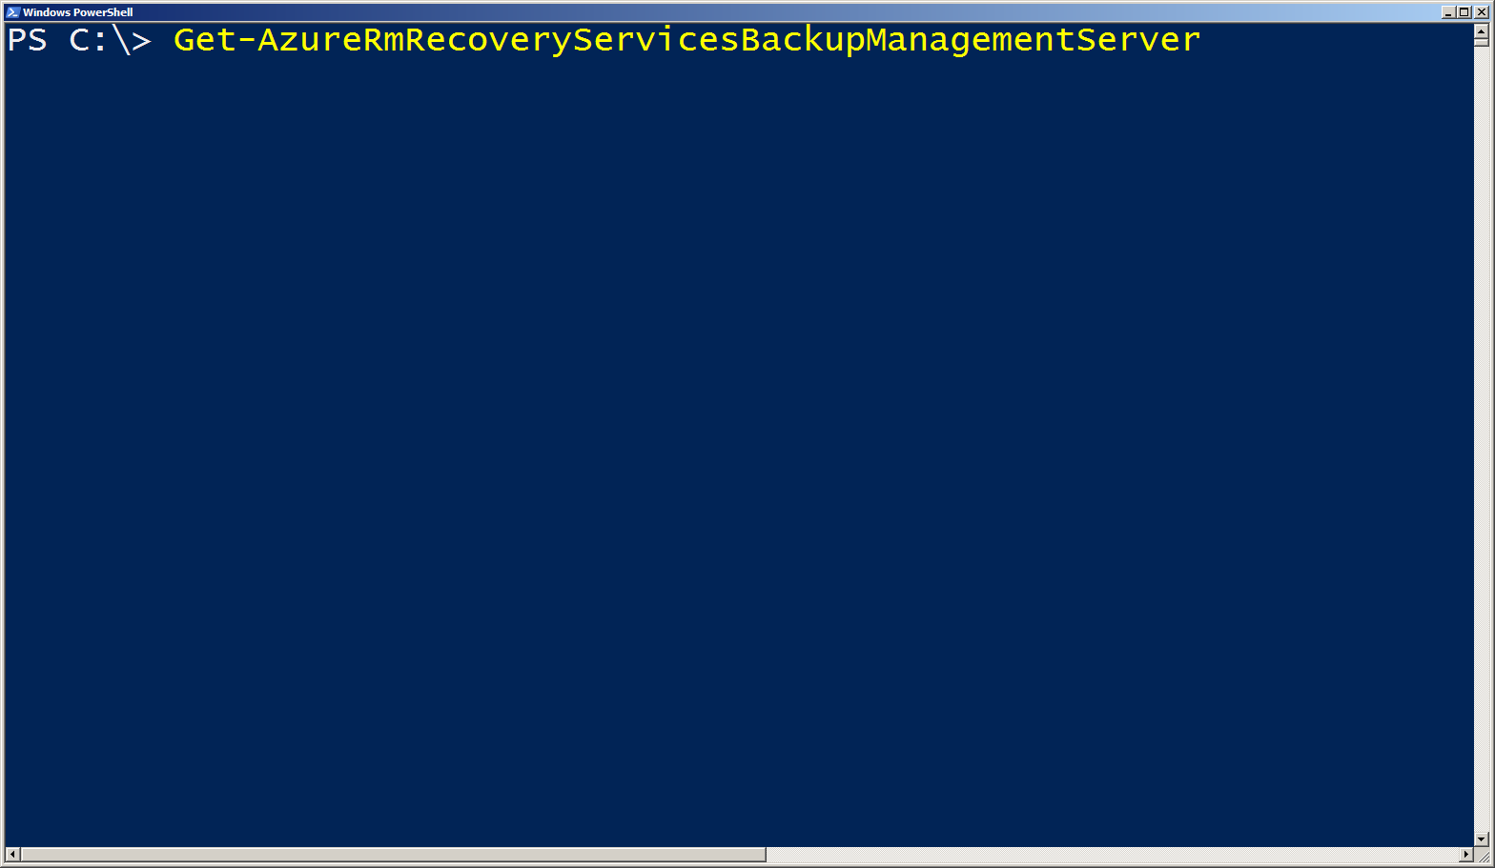
#2: Tab Auto-Complete/Ctrl+Space

Slide 13
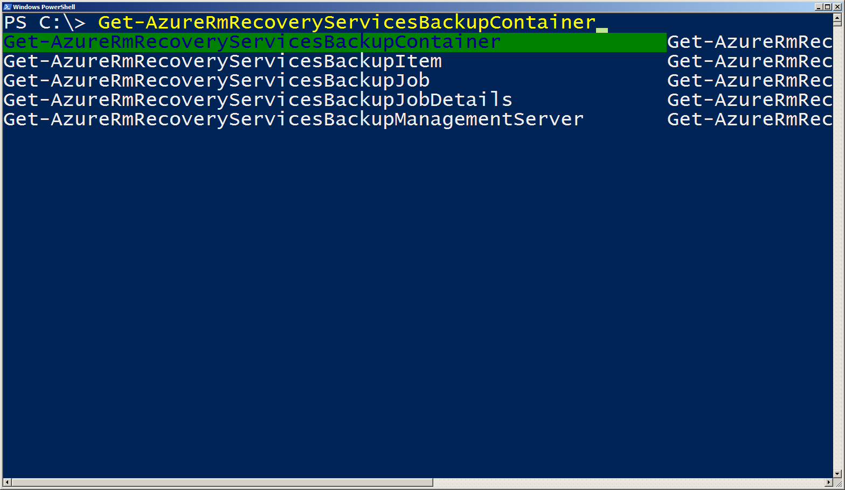
#2: Tab Auto-Complete/Ctrl+Space

Slide 14
#3: History Search with Ctrl+R
PSReadline module persists your command history across sessions
History file can be found at (Get-PSReadlineOption).HistorySavePath
Can search your command history interactively using Ctrl+R/Ctrl+S

Slide 15
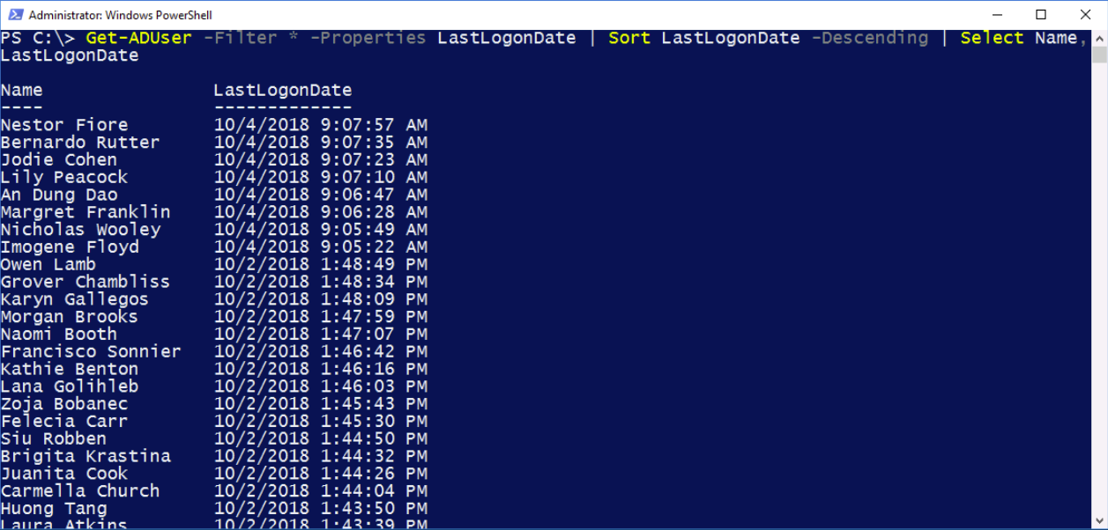
#4: Searching AD Find stale user accounts

Slide 16
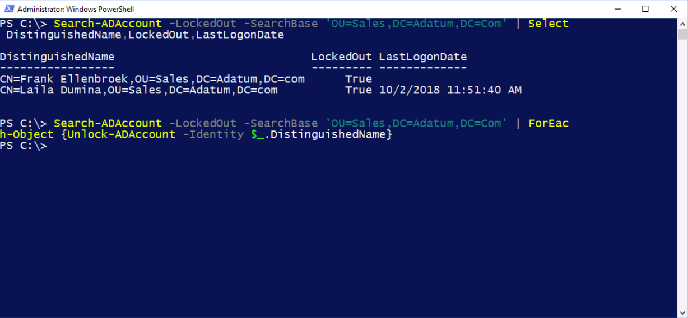
#4: Searching AD Find Locked-Out Sales User Accounts and Unlock Them

Slide 17
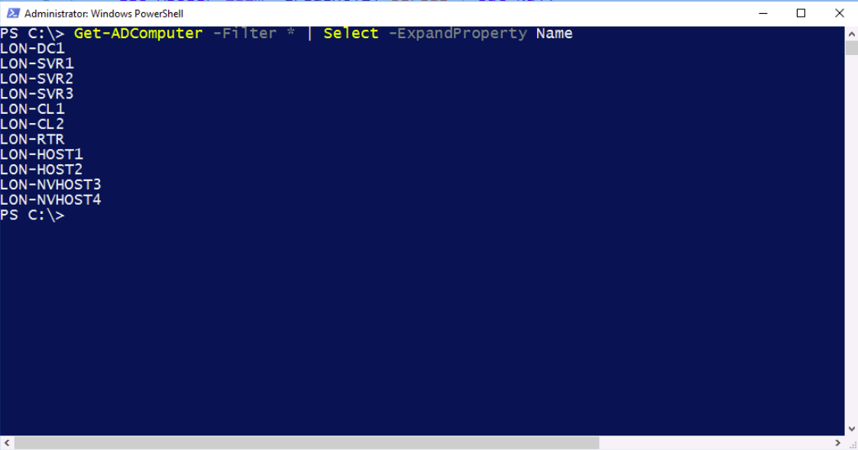
#4: Searching AD Return a list of machines

Slide 18
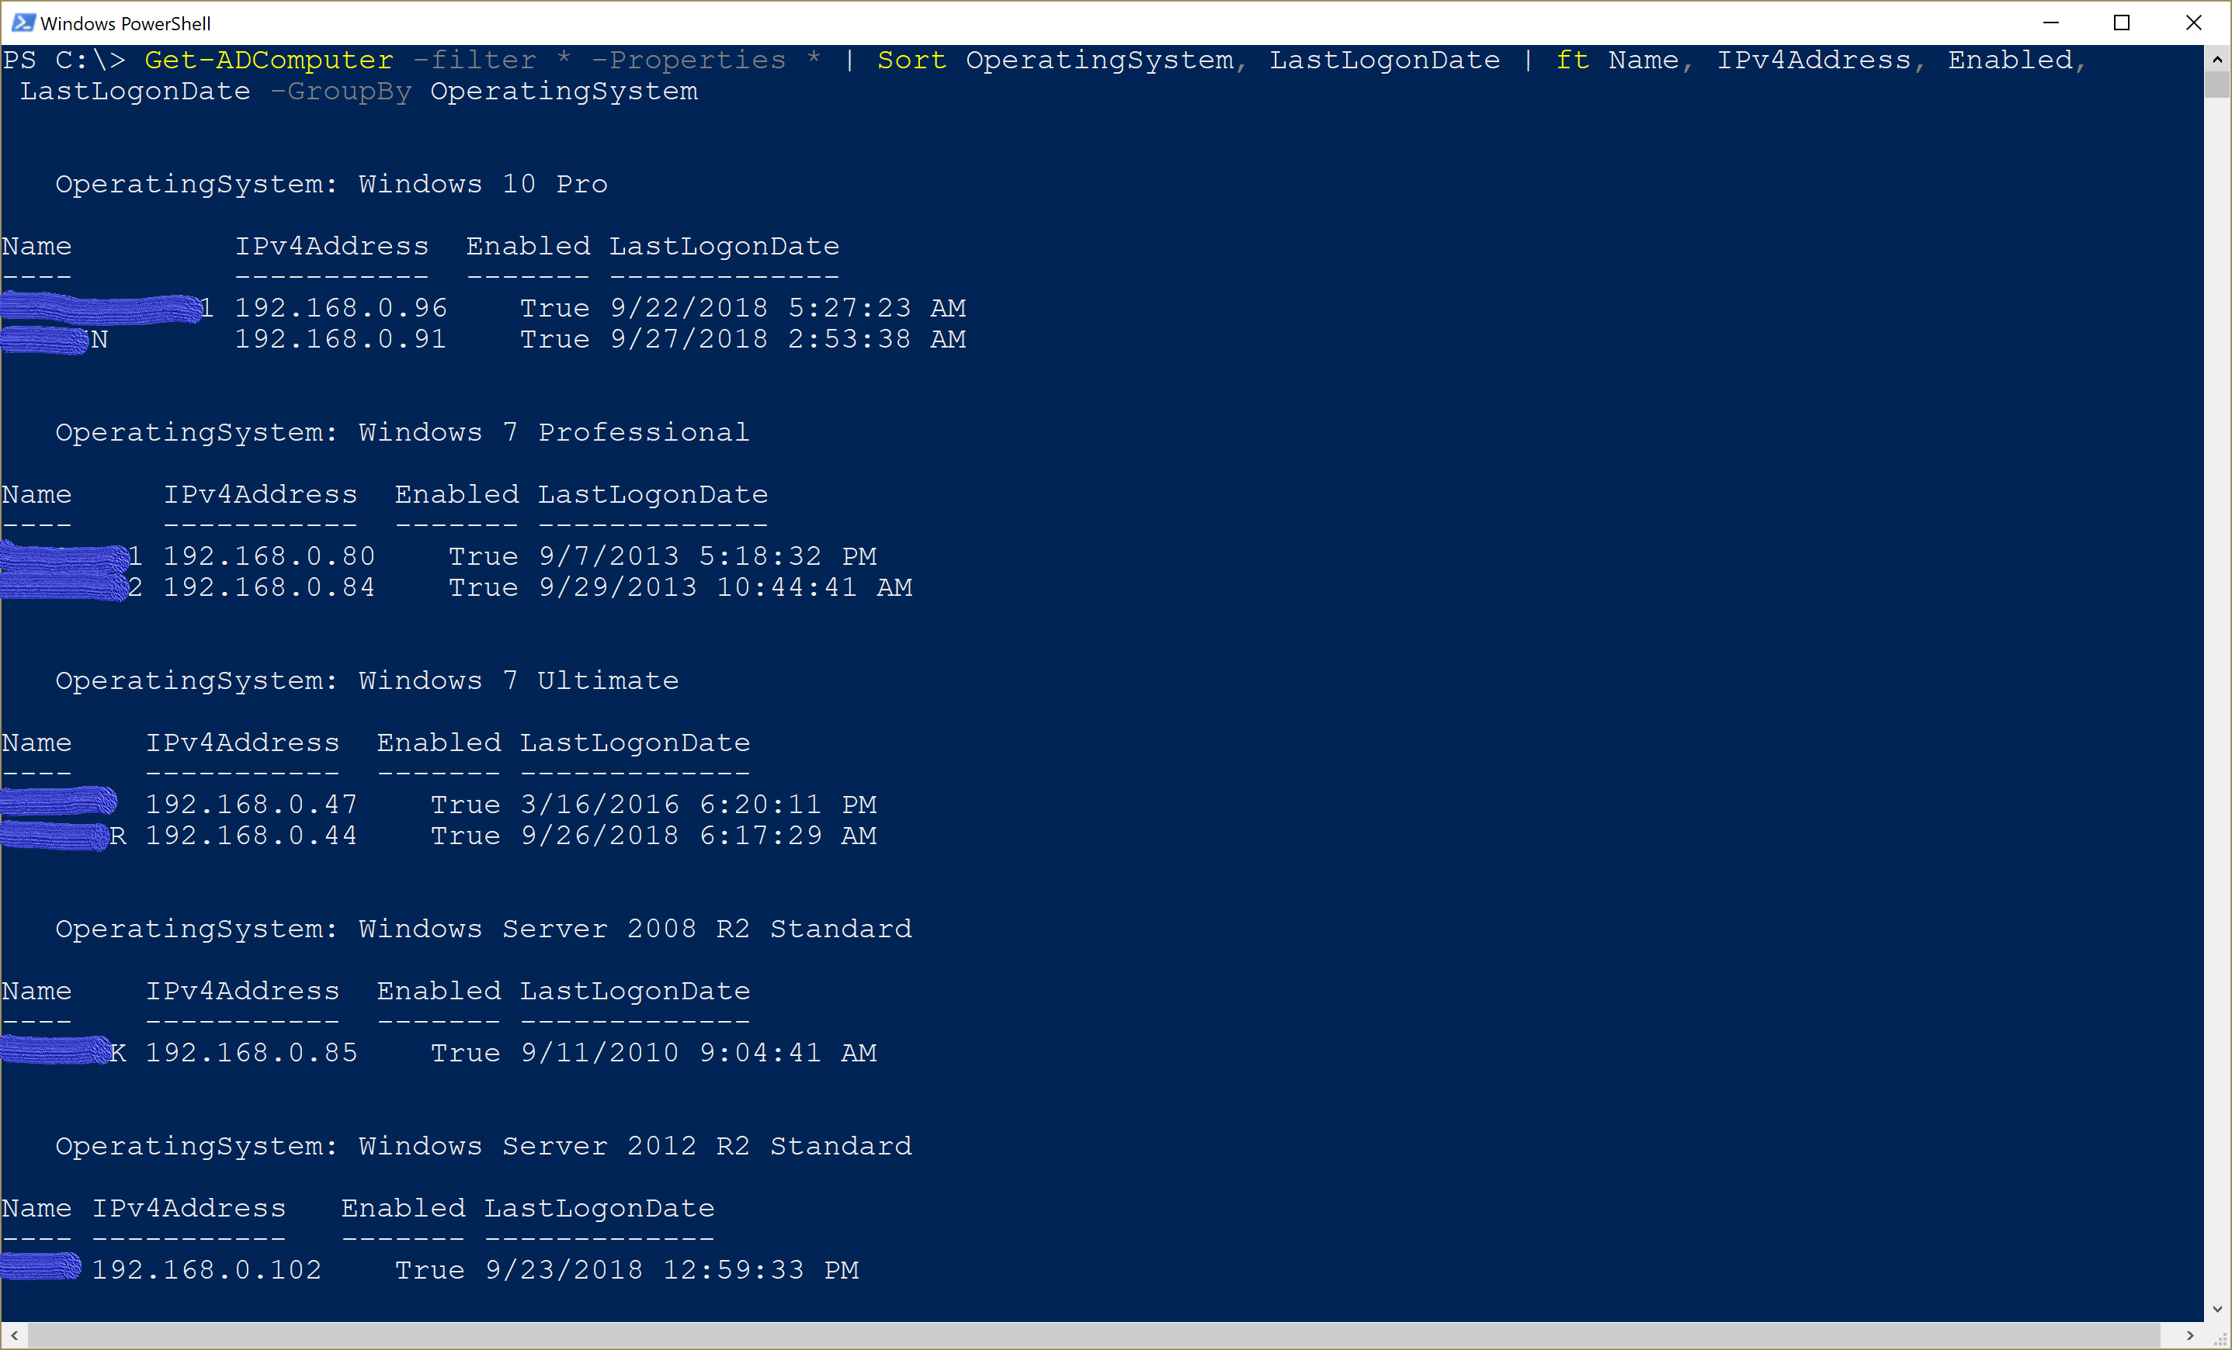
#4: Searching AD Return a list of machines grouped by operating system

Slide 19
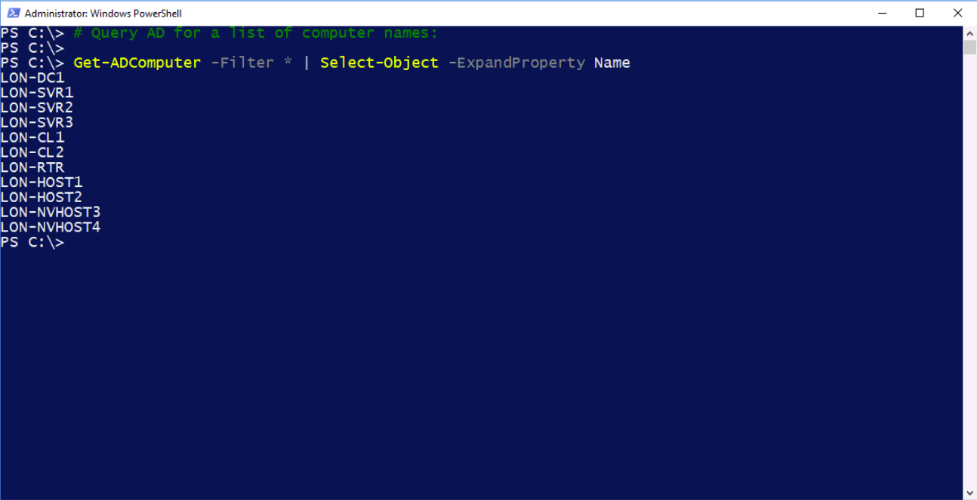
#5: Working with Collections of Systems

Slide 20
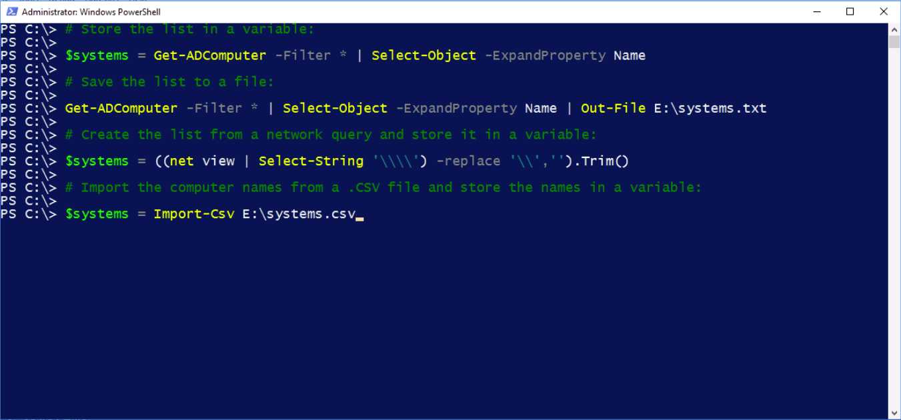
#5: Working with Collections of Systems

Slide 21
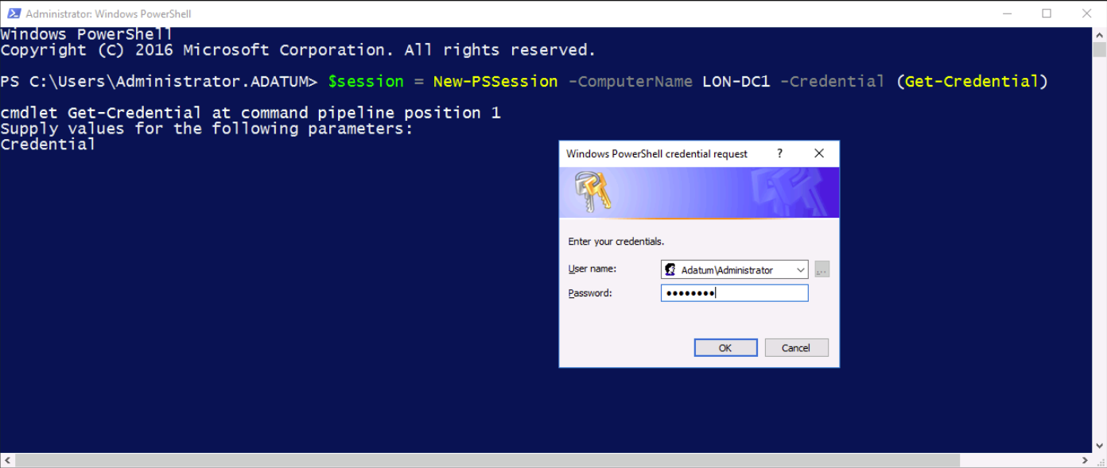
#6: Implicit Remoting

Slide 22
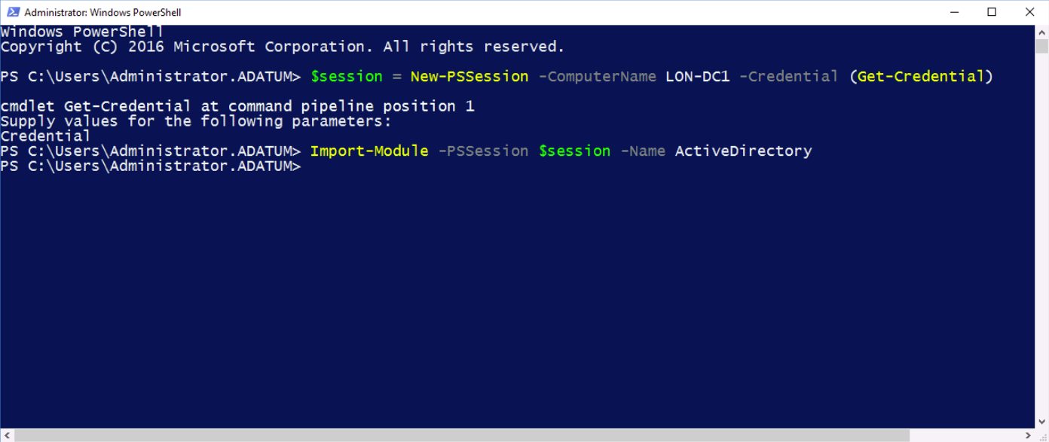
#6: Implicit Remoting

Slide 23
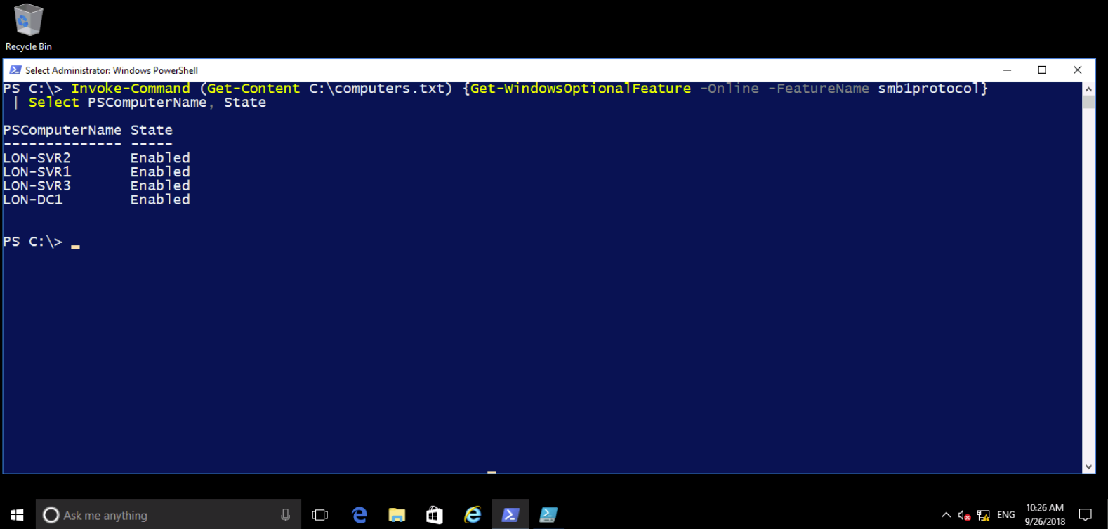
#7: Finding and Disabling SMB 1.x

Slide 24
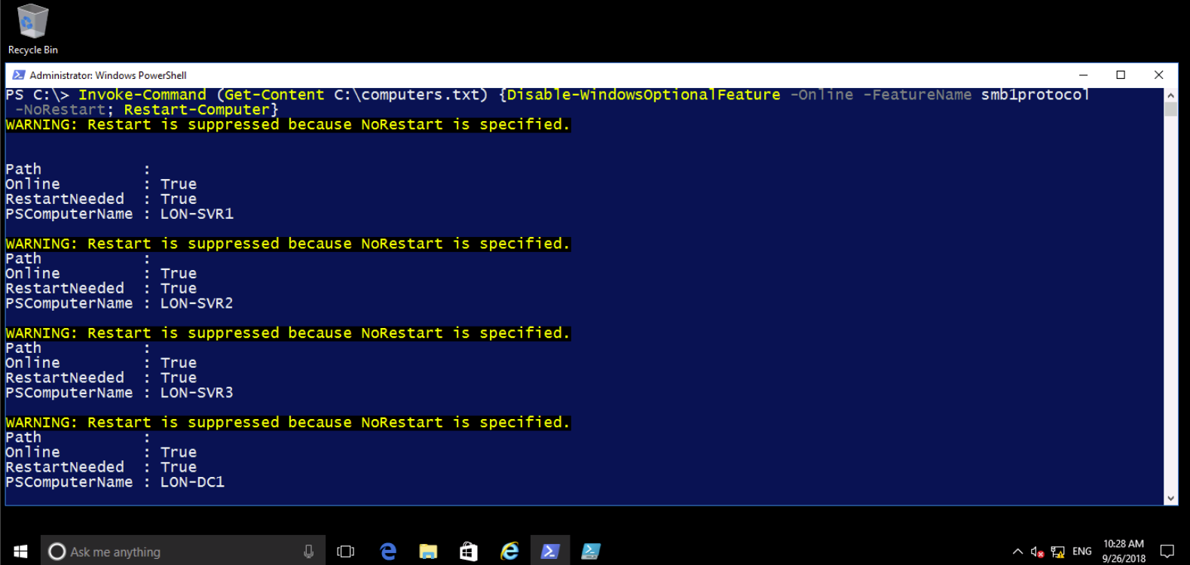
#7: Finding and Disabling SMB 1.x (continued)

Slide 25

#7: Finding and Disabling SMB 1.x (continued)

Slide 26
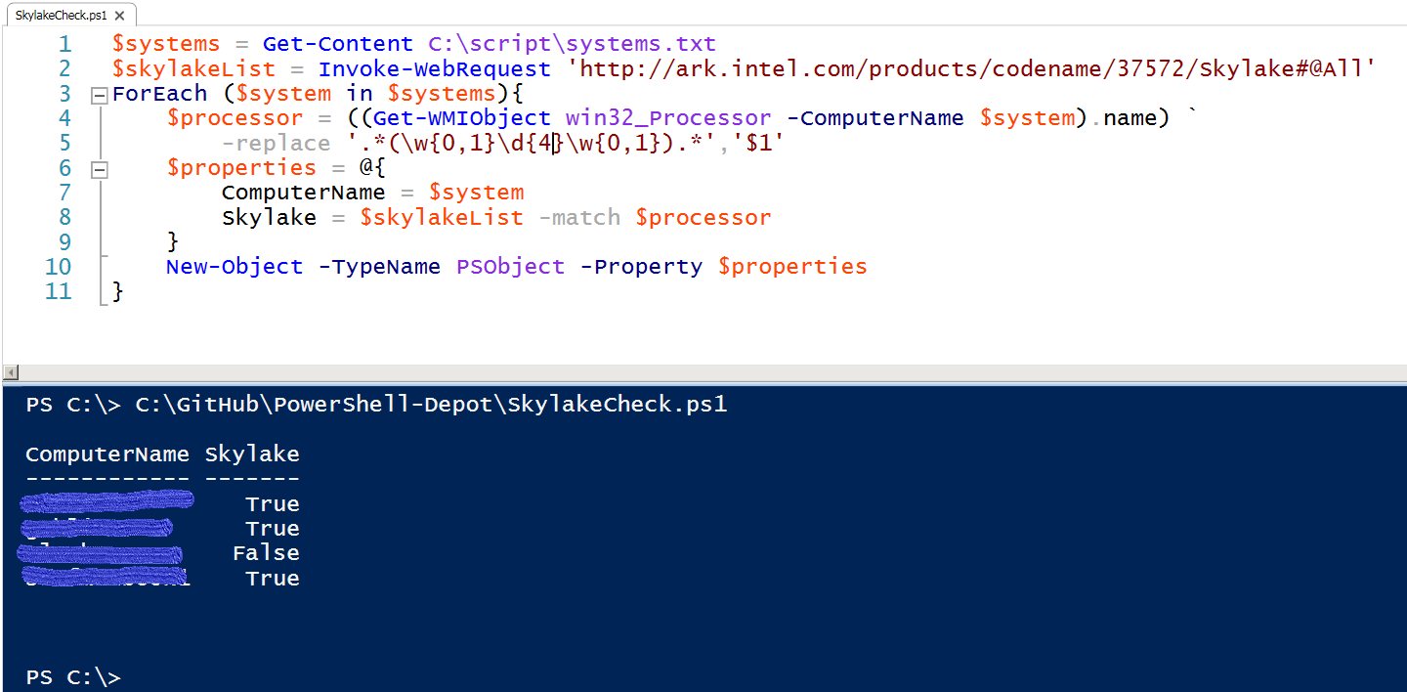
#8: Search for Skylake Processors

Slide 27
Next Steps
New Horizons PowerShell Courses
10961: Automating Administration with Windows PowerShell
10962: Advanced Automated Administration with Windows PowerShell
55202: PowerShell 5.0 and Desired State Configuration

Slide 28
Questions?
shawn.stugart@nhls.com
https://github.com/simplescripter/PS-Tricks-Webinar

